Slide 1

Rainbow class
Welcome meeting
Friday 11th September 2026

Slide 2

Information about Early Years
Phonics and Early reading
General reminders for Rainbows

Slide 3
A big thank you!
A great start to the term-children have all settled very well. Thank you for your patience at the beginning and end of the day.
Keep informed of learning on social media platforms and Tapestry
Parental involvement-3 share sessions during the year based on different areas of the EYFS curriculum (more details to follow nearer the time) EAD, Maths and Literacy focus

Slide 4
Key Person scheme
Key person scheme is requirement of EYFS curriculum and allows us to meets the needs and interests of your child.
Your child is allocated to BA and JI- list up in classroom.
This is to assist in creating a caring, safe and secure environment for your child.
BA overview of all of the children in Rainbows
Please feel free to speak to ANY member of staff if you have any questions or issues.

Slide 5
Tapestry
Linked to our tracking system, allowing you to see observations via online log in.
Notified via email when a new observation added.
Parent upload observations/videos too-we share these with the class!
Please sign and return Tapestry letter with email address/details as soon as possible!

Slide 6
EYFS Curriculum
The core aims of the EYFS curriculum is to provide the children with the best possible start and to support them to reach their full potential.
As children grow and progress the prime areas will support them to develop skills in the four specific areas.

Slide 7
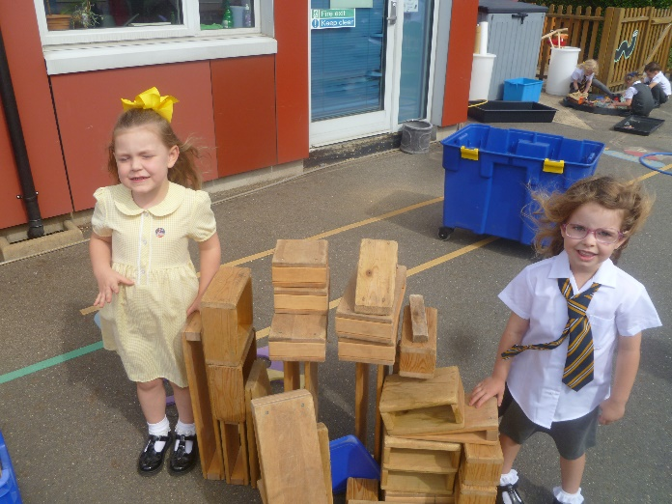
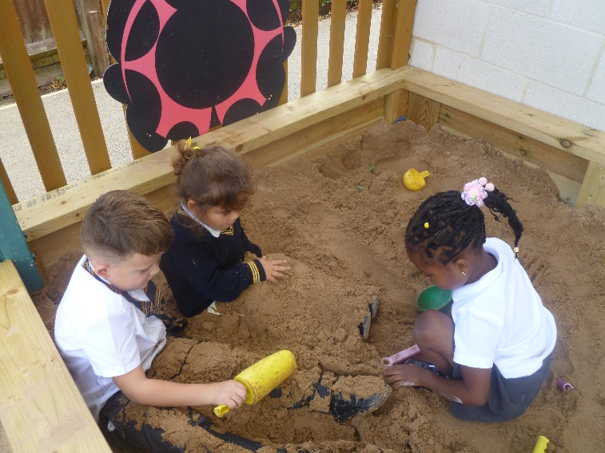
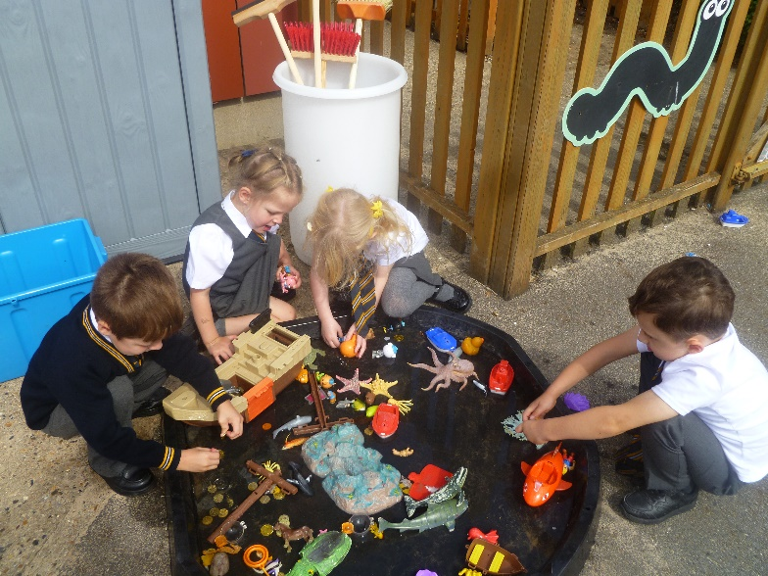
3 prime areas, which are essential for children's healthy development and future learning:
Communication and Language
Physical development
Personal, Social and Emotional development

Slide 8
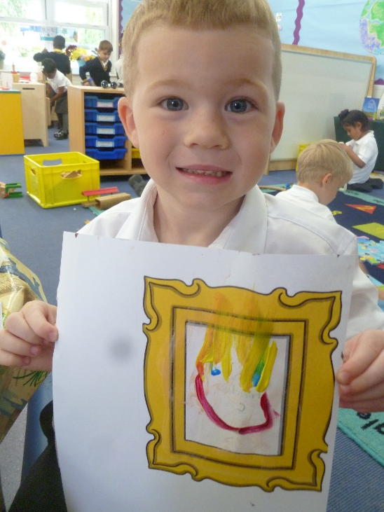
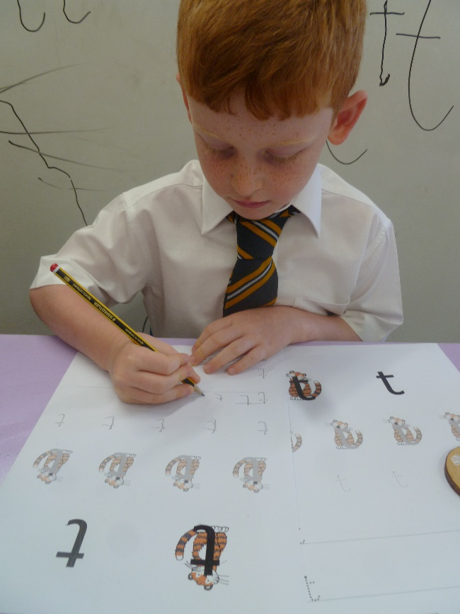
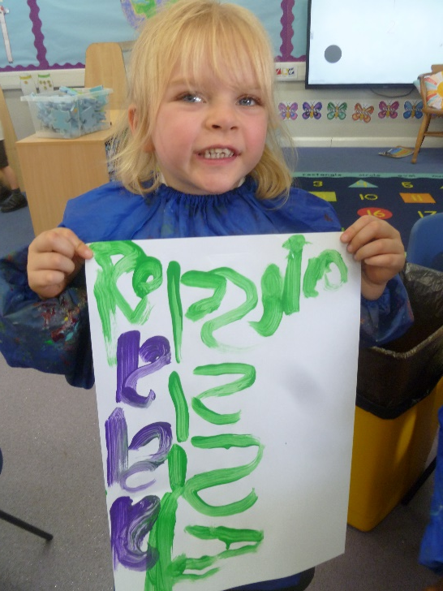
4 specific areas, to strengthen, build upon and apply learning:
Literacy
Mathematics
Understanding the World
Expressive arts and design

Slide 9
Phonics and Early Reading
Little Wandle
The programme is designed to teach children to read fluently from Reception to Year 2, using the skills of decoding and blending to read and read for pleasure also.
Whole class teaching approach-currently whiteboards which will build up to handwriting/spelling books.
In Rainbows, lessons initially start with being 10 minutes long and quickly build up to longer sessions.
Each lesson follows the same routine to avoid cognitive overload with a review session on Fridays.
Every Monday-receive overview of Little Wandle programme and pronunciation guide including home learning worksheet

Slide 10

Phonics and Early Reading
From next week, children will each have a wordless book to promote communication skills.
Please read as much as possible and record in the purple diary.

Slide 11
Reading
Reading lessons
Two times a week (Thursday and Friday)
Each lesson focuses on a different reading skill:
Decoding-translating print into speech by rapidly matching a letter or combination of letters (graphemes) to their sounds (phonemes)
Prosody – reading with expression and understanding
Comprehension – teaching the children to understand what has been read
https://www.littlewandlelettersandsounds.org.uk/resources/for-parents/

Slide 12
Reminders:
Water bottles daily-we provide fruit but welcome to bring own!
Bookbags daily- for library book, letters, phonics homework.
Spare clothes-continue to encourage independence-dressing. Named items!
Communication diary (purple)-please use to communicate to staff and record when your child has read to you.
PE- Thursday afternoon-wear PE kit all day.

Slide 13
Support at home:
Pencil grip/ cutting skills
Name writing and forming letters-NAME CARD
Number recognition to 10-practical and fun
Increasing independence-coats and jumpers

Slide 14
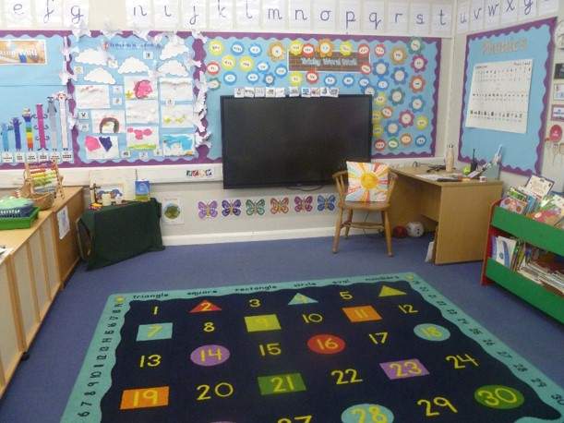
Thank you for your time!
Any questions?

